Slide 1
CS1231 Tutorial 1
AY18/19 – week 3
Andrew Tan

Slide 2
About me:
Andrew Tan
Year 2 CS major
Took CS1231 during AY17/18 Sem 1
email: andrew.tan@u.nus.edu
Consultation hours: send me an email and we can schedule something!

Slide 3
Admin matters
Attendance will be taken.
For absence, email me your medical certificate/excuse letter.
- Attending different tutorial groups: get permission from the professors.
Check your tutorial attendance on IVLE and report any discrepancies to me via email.

Slide 4
Tutorial structure
1. Content review
2. Group discussion
3. Answer presentation

Slide 5
Proofs and Logic
AY17/18 – week 3

Slide 6
1 – Proof Techniques
1. Proof by Construction
2. Proof by Counterexample
3. Proof by Contraposition
4. Proof by Contradiction

Slide 7
2 – Logical Statements
1. If-then
2. For-all

Slide 8
3 – Logical Form
Compound statements:
Negation
Conjunction
Disjunction
Statement vs. Statement form
- A statement is a sentence that is true or false, but not both
- A statement form is made up of variables that can be substituted with statements

Slide 9
4 – Logical Equivalence
Two statement forms are logically equivalent if and only if they have identical truth values for all possible substitution of statements.
If you were to construct truth tables for both statement forms, the same input for the statement variables should yield the same output for both.

Slide 10
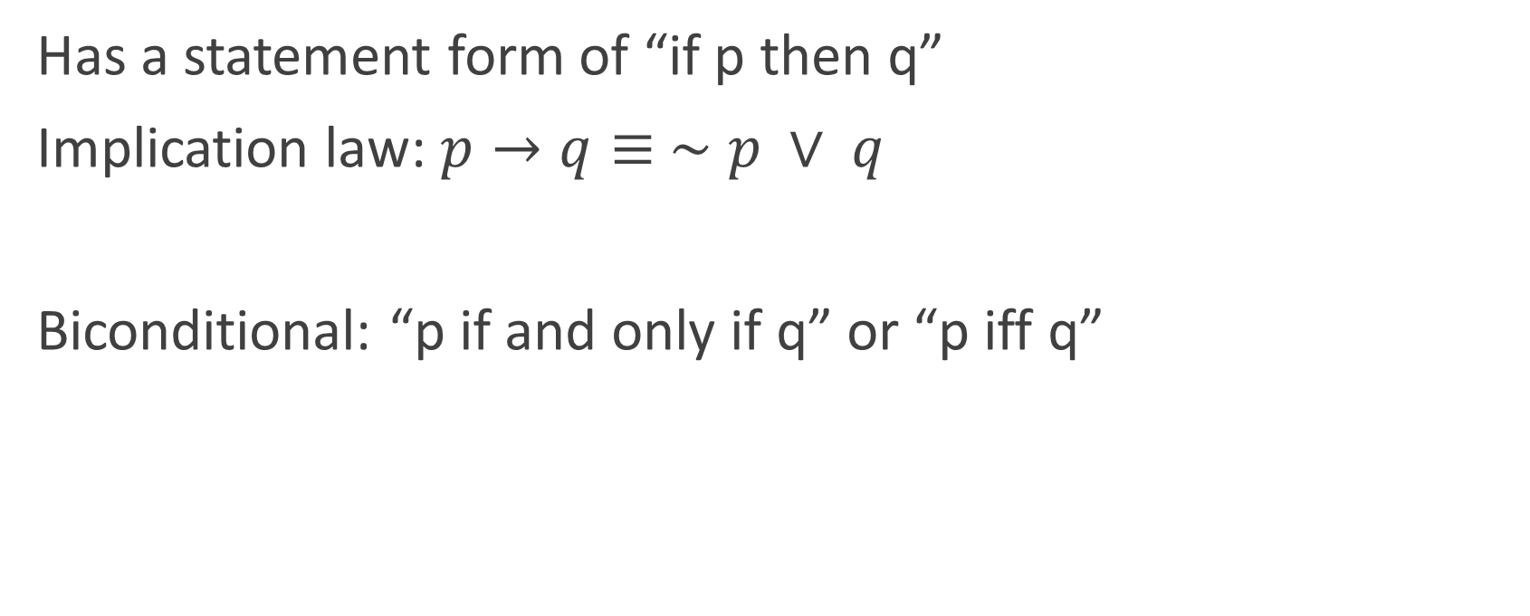
5 – Conditional statements
Has a statement form of “if p then q”
Implication law: $p→q≡ ∼p ∨ q$
Biconditional: “p if and only if q” or “p iff q”

Slide 11
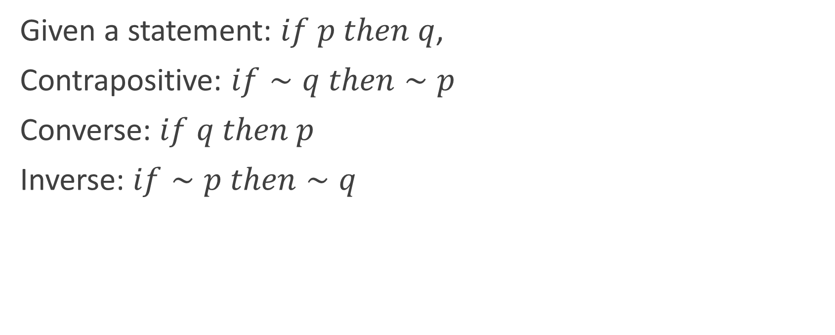
5 – Conditional Statements
Given a statement: $if p then q$,
Contrapositive: $if∼q then∼p$
Converse: $if q then p$
Inverse: $if∼p then∼q$

Slide 12
6 – Valid and Invalid Arguments
Argument – sequence of statements ending in a conclusion
Valid iff whenever all the premises are true, conclusion is also true. The truth of the conclusion is inferred/deduced from the truth of the premises.
Else, invalid

Slide 13
7 – Rules of Inference
1. Modus ponens
2. Modus tollens
3. Generalization
4. Specialization
5. Elimination
6. Transitivity
7. Division into cases

